Slide 1
Mentor-mentee recommendation system
Yana Ponomarova

Slide 2

Enron emails

Slide 3
Enron emails
Enron emails

Slide 4
Enron emails: Topics
Legal
Administrative
Trade
Gas market specifics
All related to gas and energy

Slide 5
Mentor Representation
Sum of vectorized emails they have written
Distribution of topics

Slide 6
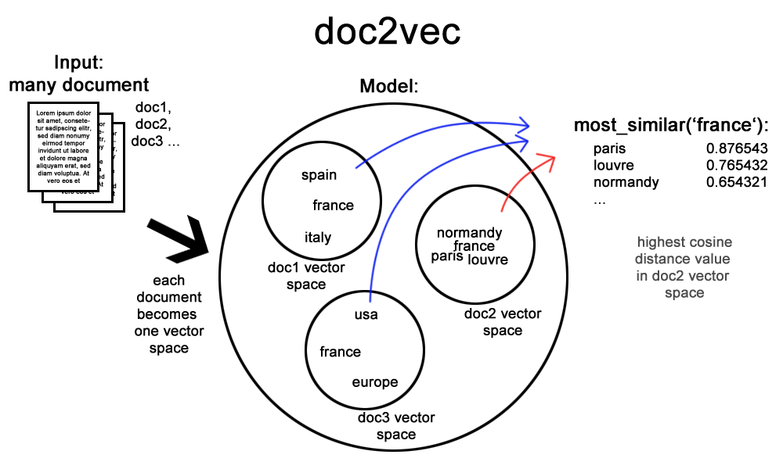
Doc2Vec

Slide 7
Doc2Vec: evaluation criteria
Sanity check:
Similarity (x, y) < similarity (x,x)
Similarity to gas
nymex | postid | calpin energi servic | midland cooper | neglig | smurfit | natur ga futur contract | nortwest | nymex rule | immatur
0.41 | 0.40 | 0.39 | 0.38 | 0.38 | 0.38 | 0.38 | 0.38 | 0.38 | 0.37
the most extensive and liquid energy marketplace with energy futures, options contracts |  | Calpine Energy Services, L.P. manages power and gas assets for wholesale customers in North America | Midland Cooperative Oil Association |  | Smurfit Kappa is a business in the field of sustainable energy | Natural Gas future contracts | NorthWestern Corporation owns NorthWestern Energy, a utility company that serves South Dakota, Nebraska, and Montana

Slide 8
Doc2Vec: evaluation criteria
most similar to “energy” and least similar to “trade”
most similar to “energy” and “trade”
promin | em | extravag | default rate | whiskey | pulp produc | jewish | contract mdq | cdwr deal | lockhe
0.37 | 0.36 | 0.34 | 0.34 | 0.33 | 0.33 | 0.33 | 0.32 | 0.32 | 0.32
Tool in Energy & Resource Development | Electromagnetic energy | Energy Extravaganza is a summit on sustainable energy |  |  | Pulp production (associated business line) |  | MDQ is a Maximum Daily Quantity is the quantity of gas a customer can request or take under a contract on any one day | CDWR is a California's Department of Water Resources | Lockheed Martin is a global security and aerospace company with extensive energy sustainability agenda
salad | liar | instituion | ga asset | broadband servic | emiss allow | coastal | erron | project socal ga dynegi phibro txu engag wesco | commerci manag market
0.41 | 0.38 | 0.38 | 0.37 | 0.37 | 0.37 | 0.37 | 0.37 | 0.37 | 0.36
 | Are traders known as liars? :-) |  | gas assets | likely clients business (energy consuming) | environment legislation | Coastal Energy Company engages in the exploration, development, and production of oil and gas properties in Thailand | typo? | SoCalGas - primary provider of natural gas to Southern California. TXU - Texas Electricity Company. Wesco Energy - full service home heating supplier | Commercial management market

Slide 9
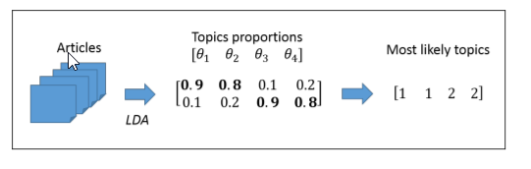
LDA

Slide 10
LDA evaluation criteria
Perplexity
Meaningfullness of topics

Slide 11
Interesting findings
Everything is about gaz and trade
Not surprising, given that «Enron Corporation was an American energy, commodities, and services company based in Houston, Texas» - Wikipedia
Email vector representation:
Models with chunks + tokens > model with chunks > model with tokens
TFIDF > CountVectorizer
Spark implementation of LDA lack predictive functions

